Slide 1
Improving the FIFA ranking system using probabilistic modeling and prediction of the UEFA EURO 2016 tournament
Tom Van de Wiele
Promotor: Christophe Ley

Slide 2

“Beating Cristiano Ronaldo in the UEFA EURO 2016 tournament with a virtual football player”
Coach: Tom Van de Wiele
Chairman: Christophe Ley

Slide 3




This should make sense in 15 minutes

Slide 4
Overview
FIFA ranking / Opponent description
Model / Player description
Predictive performance measure / Referee
Let’s play!
Premier league
National team matches
UEFA Euro 2016

Slide 5

FIFA ranking / opponent description
Main ranking for national football teams
Significant disadvantages
Arbitrary decay function
Unfair to small federations and weaker countries
Can not be used to generate match outcome predictions
Used to generate draw at qualififcation and final stage
of major tournaments

Slide 6
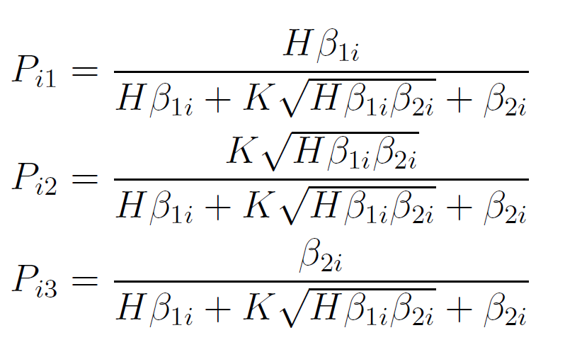
Model / player description 1 Bradley-Terry model
Basic statistical model
Only considers match outcomes
Contains a home and a tie effect
ML parameter estimation
Can be used to predict match outcomes

Slide 7
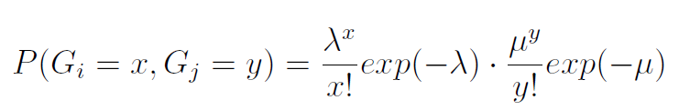
Model / player description 2 Poisson model
Assumes independent Poisson distribution for scored goals
Additional parameter for the home effect
ML parameter estimation
Uses match results

Slide 8

Model / player description 3 Elo model
Simple update formula
Ratings are updated after each match
Uses match results

Slide 9
Model variations
Decay function
Relaxation of predictions
Number of parameters for each team
Blend of Bradley-Terry and Poisson

Slide 10

Predictive performance measure / Referee
Goal: predict match outcome probabilities
Optimizing the log loss criterion corresponds with the actual
outome probabilities
Heavy penalty on low actual outcome probabilities

Slide 11
Competition 1: Premier League data (1)
Analysis between 2000 and 2015
Poisson >> BT > Elo
1 strength parameter > 2 strength parameters
Comparison of best model with gold standard...

Slide 12
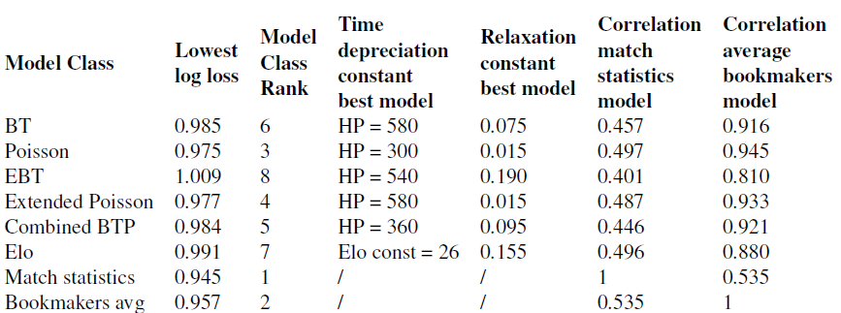
Competition 1: Premier League data (2)

Slide 13
Competition 1: Premier League data (3)
9 bookmakers

Slide 14
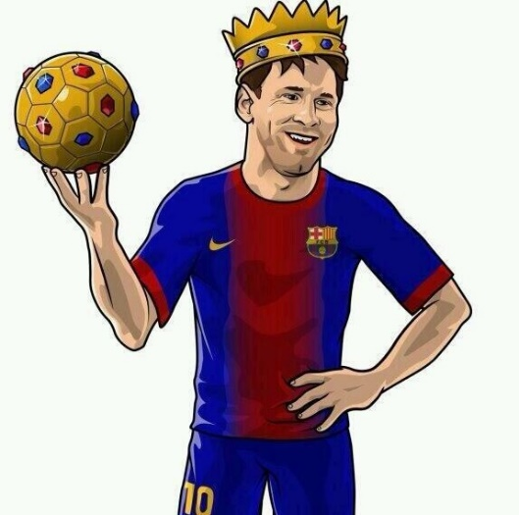
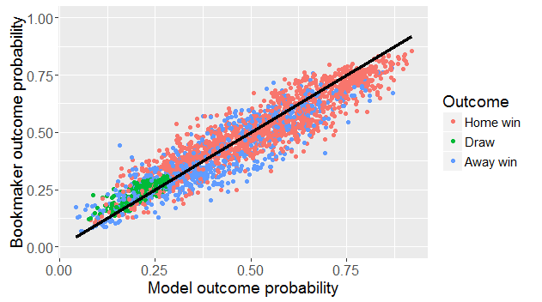
Competition 1: Premier League data (4)
Bookmakers > Poisson. Correlation of 94.5%

Slide 15
Competition 2: National team matches (1)
Analysis of national team matches between 1992 and 2015
Poisson >> BT > Elo
1 strength parameter > 2 strength parameters
Select the preferred Poisson national team model
No gold standard data available

Slide 16
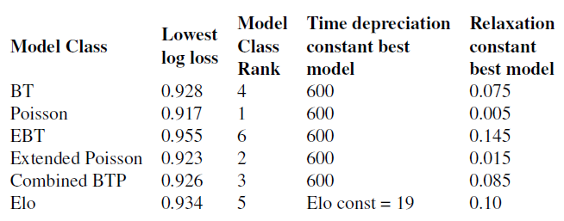
Competition 2: National team matches (2)

Slide 17
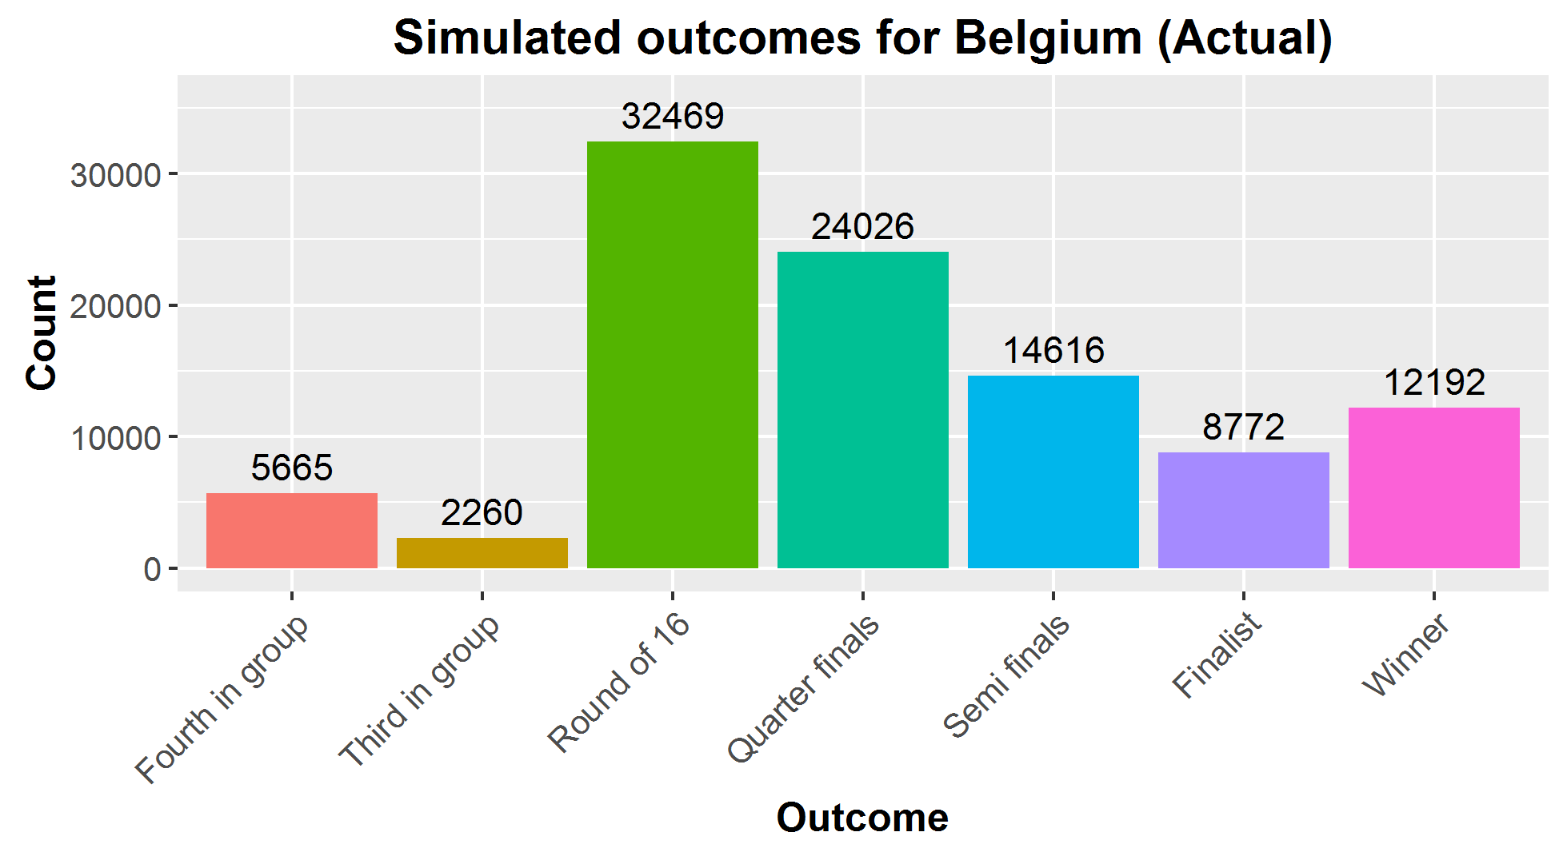
Competition 3: UEFA EURO 2016 (1)

Slide 18
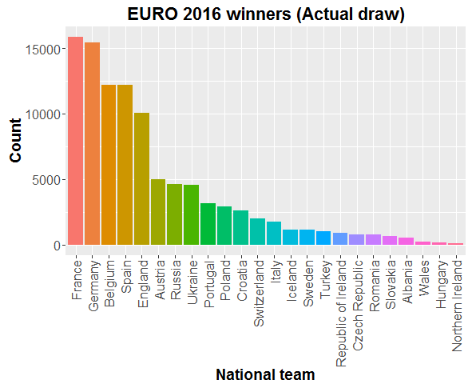
Competition 3: UEFA EURO 2016 (2)

Slide 19
Competition 3: UEFA EURO 2016 (3)
Before competition:
Poisson rank closer to bookmaker rank than FIFA ranking
Competition is ongoing
First round summary...

Slide 20
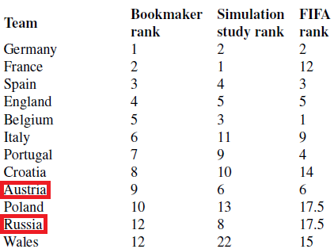
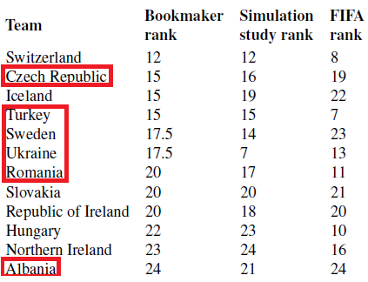
Not a statistical analysis Bookmaker rank > Poisson model / FIFA rank

Slide 21
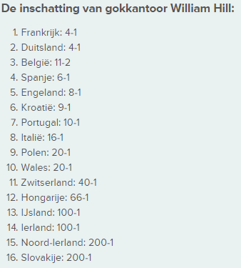
Not a statistical analysis Bookmaker snapshot June 23, 2016

Slide 22
Conclusion
Statistical models enable the prediction of match outcomes
Poisson >> BT > Elo
Strong correlation between Poisson model predictions and bookmaker predictions

Slide 23
Questions?

